Slide 1
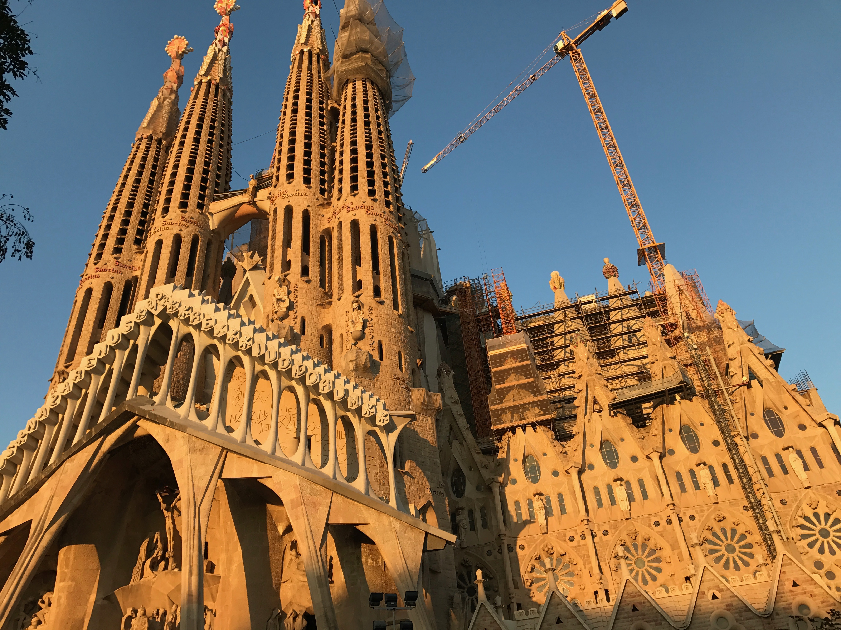
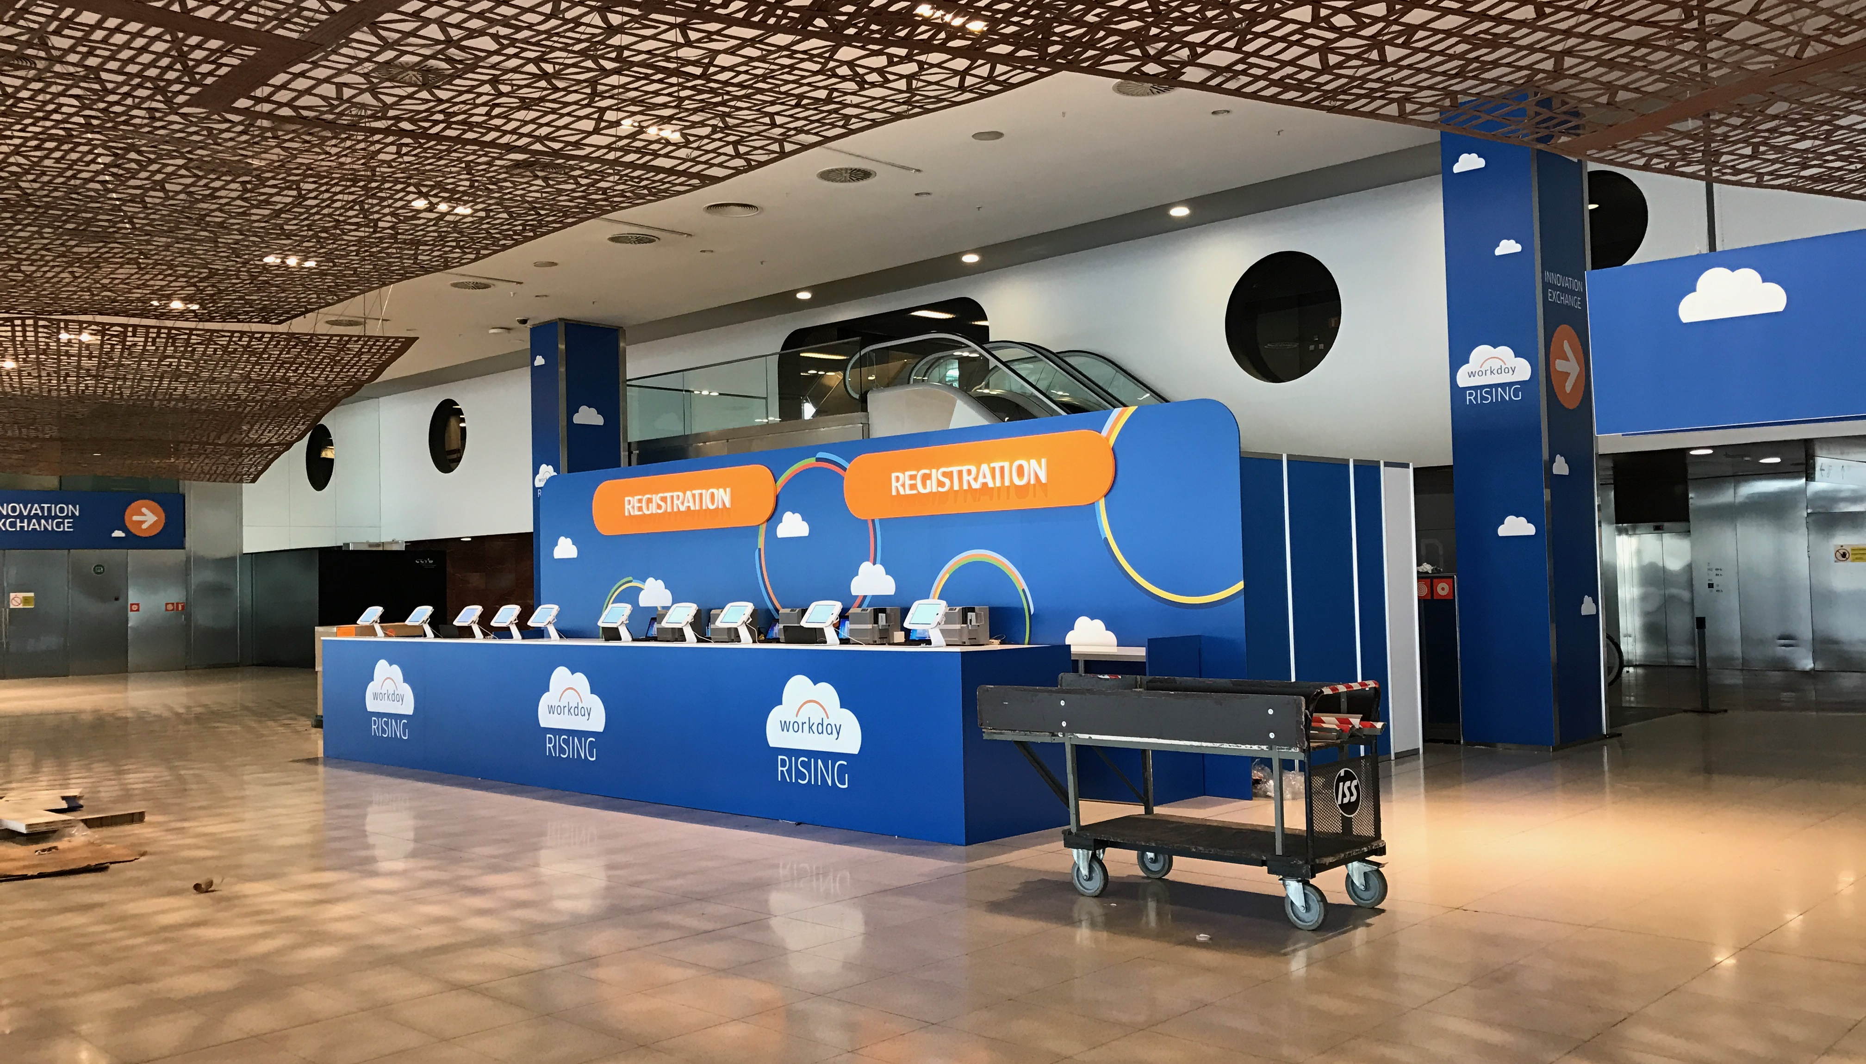
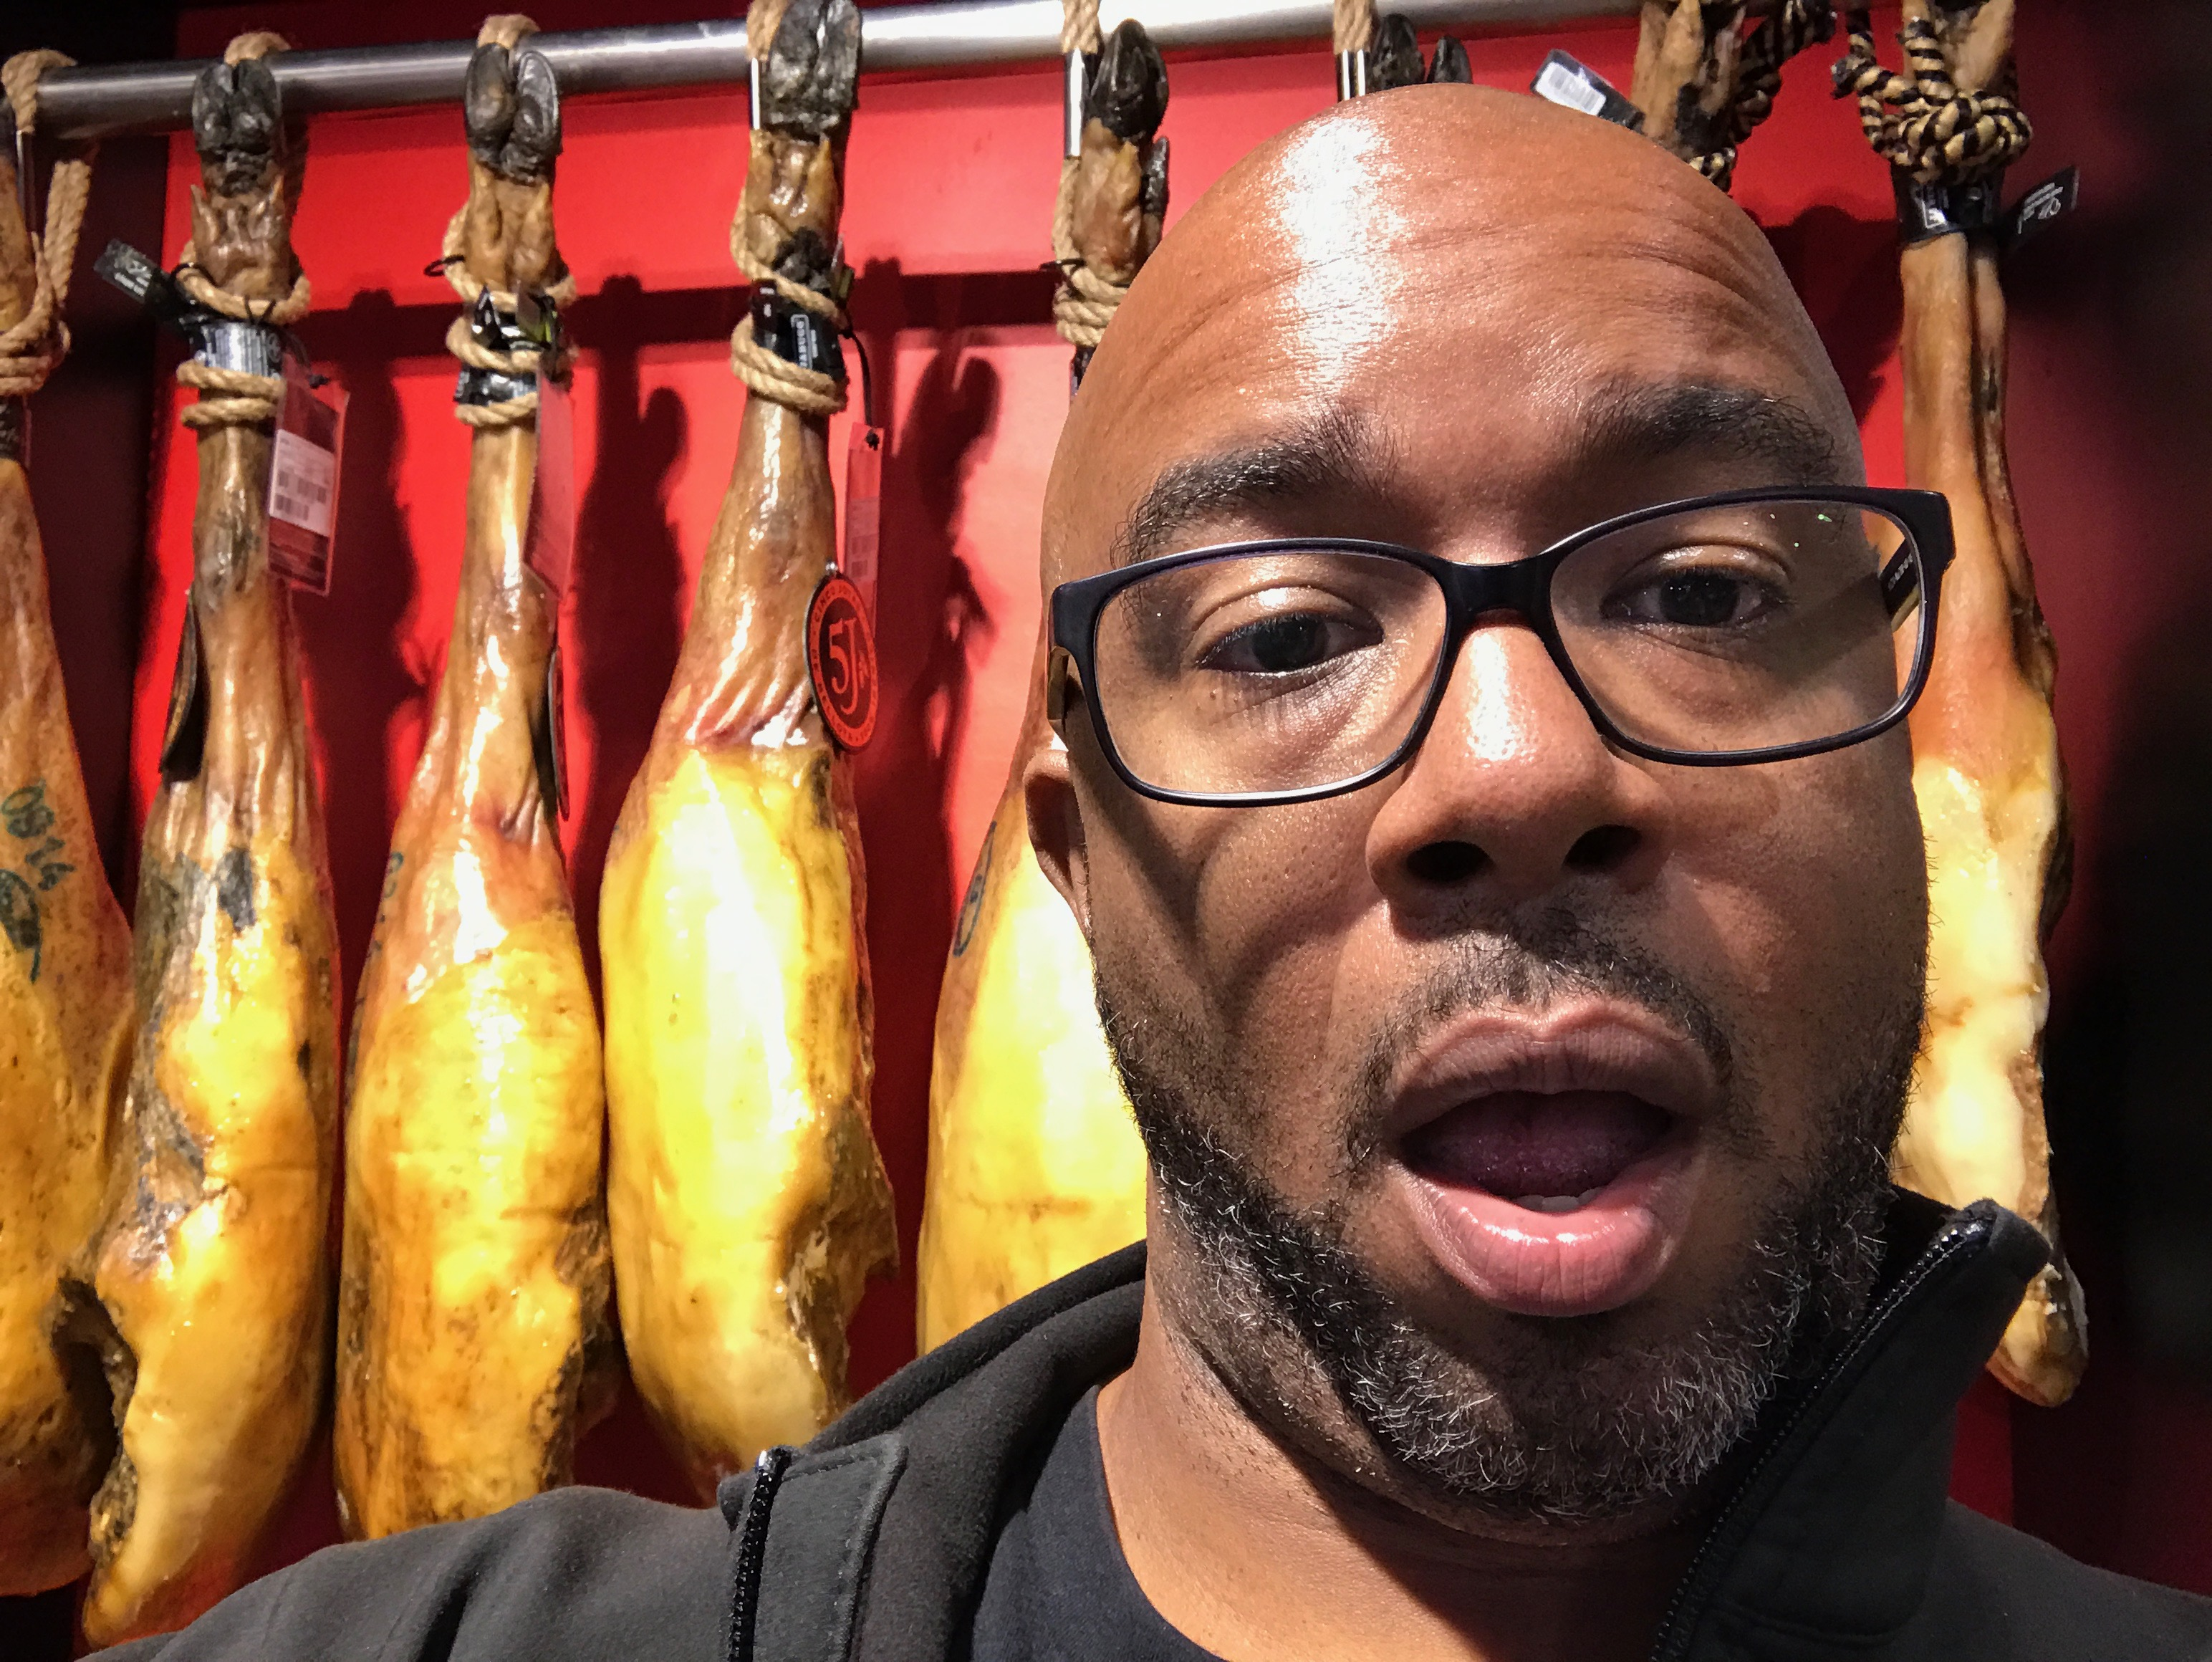
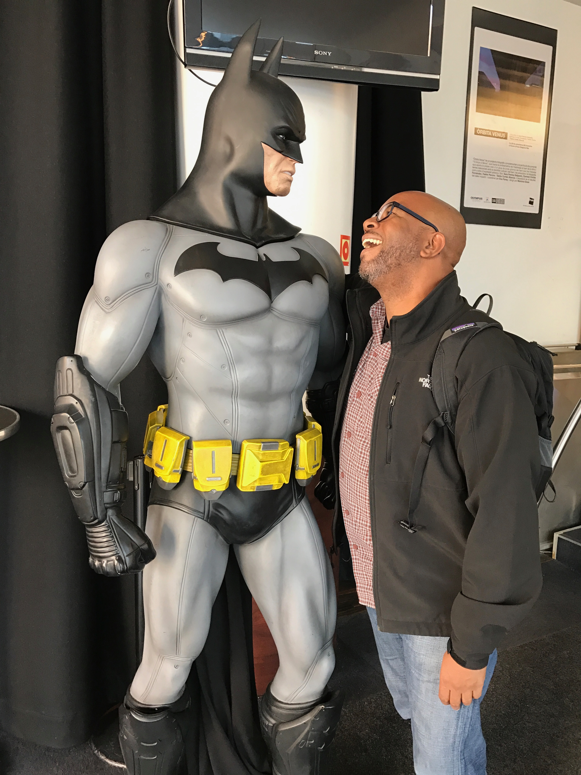
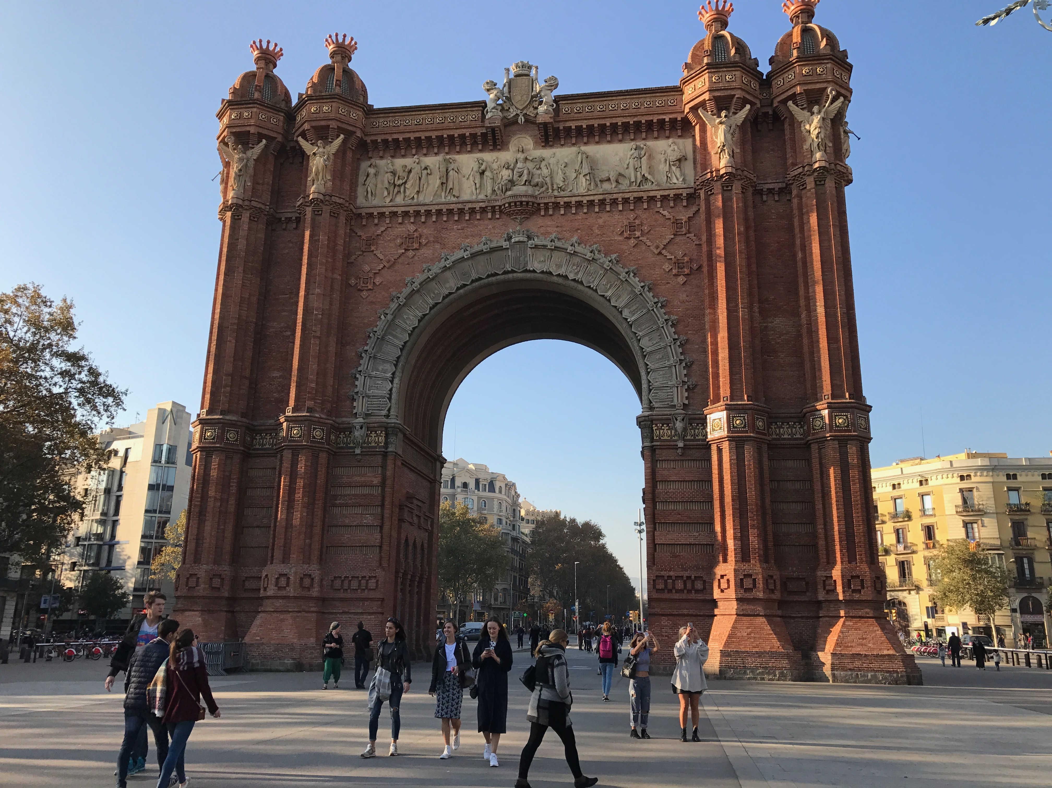
Notes:
It’s taken me to Barcelona where I got to work on a presentation for Workday, see some amazing sights, and take photos of myself in front of legs of Iberico ham.

Slide 2
Notes:
It’s taken me to Barcelona where I got to work on a presentation for Workday, see some amazing sights, and take photos of myself in front of legs of Iberico ham.

Slide 3
Notes:
It’s taken me to Barcelona where I got to work on a presentation for Workday, see some amazing sights, and take photos of myself in front of legs of Iberico ham.

Slide 4
Notes:
It’s taken me to Barcelona where I got to work on a presentation for Workday, see some amazing sights, and take photos of myself in front of legs of Iberico ham.

Slide 5
Notes:
It’s taken me to Barcelona where I got to work on a presentation for Workday, see some amazing sights, and take photos of myself in front of legs of Iberico ham.

Slide 6
Notes:
It’s taken me to Barcelona where I got to work on a presentation for Workday, see some amazing sights, and take photos of myself in front of legs of Iberico ham.

